Slide 1

HARCOURT BUTLER TECHNICAL UNIVERSITY
DEPARTMENT OF MATHEMATICS
SEMINAR PRESENTATION ON
TOPIC : STRUCTURED QUERY LANGUAGE
PRESENTED BY :
ANKIT SINGH
ROLL NO : 220227003

Slide 2

TABLE OF CONTENT
Introduction to SQL and MySQL
What is Database and its types
Characteristics of Databases
What is SQL
Uses of SQL
Basics of SQL Syntax
Keypoints of SQL Syntax
Statements used in SQL
Filtering Data in SQL
Real life Implementation in SQL
Examples in SQL
Pros.
Cons.
Conclusion
References

Slide 3
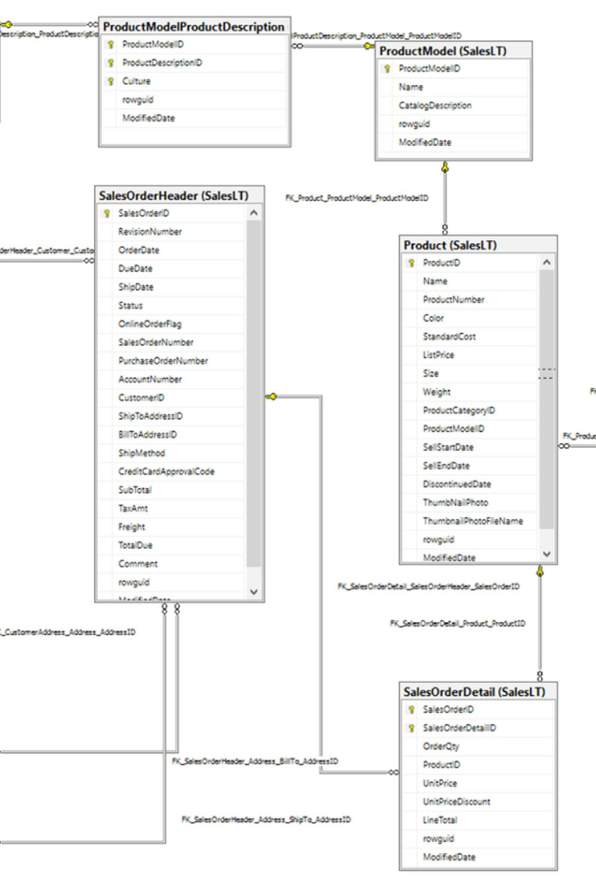
Introduction to SQL & MySQL
In today's data-driven world, SQL is a foundational for anyone working with data.
It allows users to interact with databases, manipulate data, and extract meaningful insights.
Whether you're a data analyst, data scientist, or a business professional, understanding SQL is essential for effectively working with data.

Slide 4

WHAT IS DATABASE?
database is an organized collection of structured information or data stored electronically in a computer system.
It's designed to efficiently manage, store, retrieve, and manipulate data according to predefined requirements.
Databases serve as repositories for various types of information, allowing users and applications to access, update, and manage data.

Slide 5

Types of Databases
Relational Databases: Organize data into tables with predefined relationships between them, following the relational model.
Examples include MySQL, PostgreSQL, SQL Server.
2.NoSQL Databases: Handle unstructured or semi-structured data, providing flexible schema design and scalability.
Examples include MongoDB, Cassandra, Redis.
3.Graph Databases: Designed for managing highly interconnected data, utilizing graph structures to represent relationships between data entities.
Examples include Neo4j, Amazon Neptune.

Slide 6

Characteristics of Databases
Structured Storage: Data is organized in a structured format, typically using tables, rows, and columns, enabling efficient retrieval and manipulation.
Data Integrity: Databases enforce rules and constraints to maintain accuracy and consistency of data, ensuring its reliability.
Security: Databases provide mechanisms to control access, authentication, and authorization, safeguarding sensitive information.
Scalability: Databases can scale vertically (by adding resources to a single server) or horizontally (by distributing data across multiple servers) to accommodate growing data volumes

Slide 7

WHAT IS SQL?
SQL is a programming language used for managing and manipulating relational databases.
It stands for Structured Query Language.
It is used to create, modify, and retrieve data from databases.

Slide 8
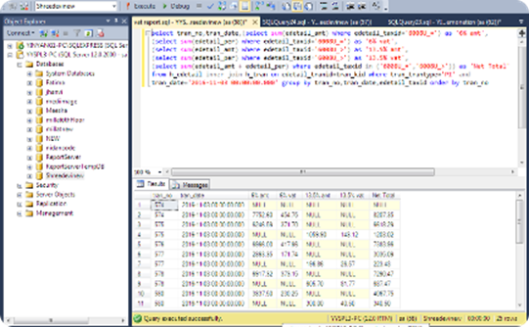

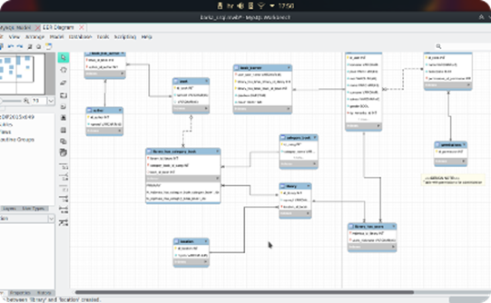
Uses of SQL
Data Management
Query Language
Database connectivity
SQL is designed to handle large volumes of data efficiently, providing means for storage, retrieval, and manipulation of structured information.
It is a standard language for accessing and managing databases, allowing users to perform tasks such as updating data, running queries, and creating reports.
SQL facilitates seamless communication with database servers, enabling applications to interact with the stored data effectively.

Slide 9
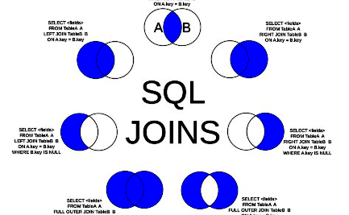
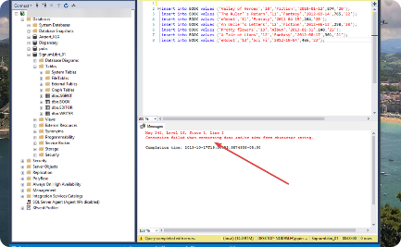
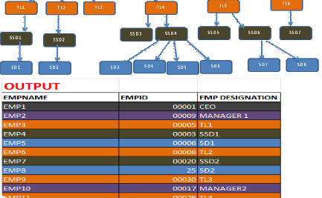
Basics of SQL syntax
Structured Language
Key Components
Logical Operators
SQL syntax follows a specific structure, including keywords, expressions, and clauses. Understanding the basic syntax is crucial for writing effective queries and commands.
Learning the fundamental components of SQL syntax, such as SELECT, FROM, and WHERE, lays the foundation for building more complex and powerful database operations.
SQL syntax incorporates logical operators like AND, OR, and NOT, which are essential for defining conditions and filtering data effectively.

Slide 10

Key points of SQL syntax
1
Statements
SQL syntax includes various statements such as SELECT, INSERT, UPDATE, and DELETE to perform specific tasks on the database.
2
Functions
SQL syntax incorporates a range of functions for data manipulation, transformation, and computation, providing flexibility in query construction.
3
Clarity and Readability
Basic SQL syntax is designed for intuitive readability, making the code easy to understand and maintain for database developers.

Slide 11

STATEMENTS USED IN SQL
SELECT Statement:
Retrieve Data from a database.
SYNTAX:
SELECT column1, column2, ...
FROM table_name
WHERE condition;
INSERT INTO Statement:
Add a new record to the table.
SYNTAX:
INSERT INTO table_name (column1, column2, ...)
VALUES (value1, value2, ...);
UPDATE Statement:
Modifying existing record in the table.
SYNTAX:
UPDATE table_name
SET column1 = value1, column2 = value2, ...
WHERE condition;

Slide 12

FILTERING DATA USED IN SQL
WHERE Clause:
Filter records returned by ‘SELECT’,’UPDATE’,’DELETE’ Statement.
SYNTAX:
SELECT column1, column2, ...
FROM table_name
WHERE condition;
LOGICAL Operators:
SQL provides logical operators such as AND, OR, and NOT to combine multiple conditions for more complex data filtering.
SYNTAX:
SELECT * FROM table_name WHERE condition1 AND condition2;

Slide 13



Joining tables to combine data
Inner Join
Outer Join
Cross Join
Combines rows from two or more tables based on a related column between them and excludes non-matching records.
Retrieves rows from one or more tables, including all matching rows and displaying NULL values for non-matching records.
Returns the Cartesian product of rows from multiple tables, creating combinations of all rows between the tables.

Slide 14
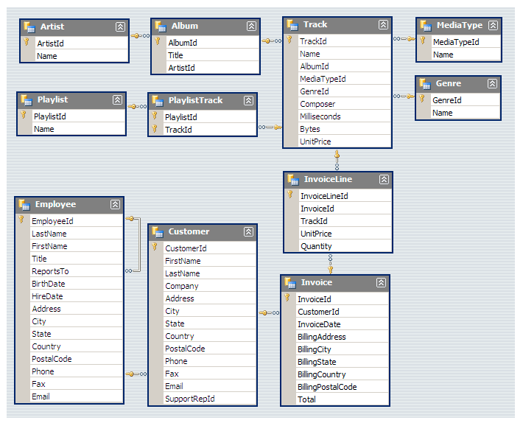
REAL LIFE IMPLEMENTATION IN SQL
Digital Music Store Analysis :
Analyzing a music store database involves extracting insights from the data it contains.
1. Understanding the Database Schema:
Review the structure of the music store database. Understand the tables, relationships, and the data they store.
2. Connecting to the Database:
Use a SQL client or command-line interface to connect to the music store database.

Slide 15
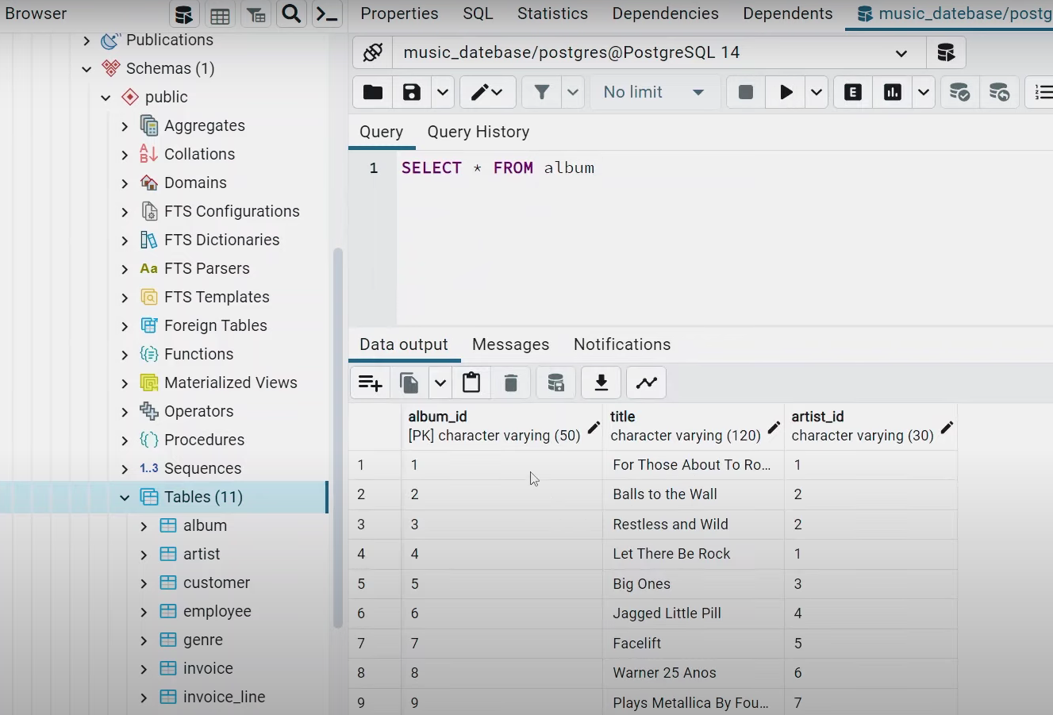
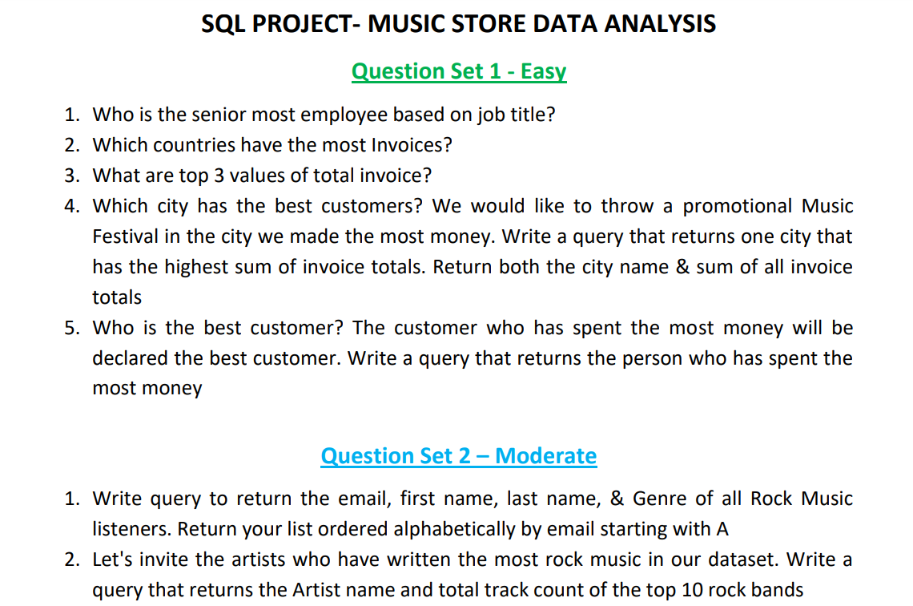
3. Exploratory Queries:
Write basic queries to explore the data.
4. Data Cleaning and Transformation:
Identify any inconsistencies or missing data.
Clean the data by removing duplicates, handling null values, or standardizing formats.
5. Performing Analysis:

Slide 16

Real-life examples of SQL implementation
1
Data Analytics
SQL is widely used in data analytics for querying and processing large datasets to extract meaningful insights and trends.
2
Web Development
Many websites and web applications implement SQL for managing user data, content management, and dynamic content generation.
3
Business Reporting
SQL is integral to business reporting, providing the functionality to retrieve, analyze, and present data for decision-making purposes.

Slide 17
PROS:
Ease of Use: SQL has a relatively simple syntax, making it easy to learn and use, especially for querying and managing relational databases.
Standardization: Being a standardized language, SQL allows for portability across various database platforms, making it easier to transfer skills and code between systems.
Robustness: It can handle complex queries and database operations, supporting a wide range of functionalities like data retrieval, manipulation, and administration.
Scalability: SQL databases can scale vertically by adding more resources to a single server or horizontally by distributing data across multiple servers.
Data Integrity: SQL supports constraints (e.g., foreign keys, unique keys) ensuring data integrity, reducing the risk of inconsistent or incorrect data.
Security: SQL databases provide strong security features, including user access controls, encryption, and authentication mechanisms, safeguarding sensitive data.

Slide 18
CONS :
Limited Support for Non-Relational Data: SQL is primarily designed for relational databases, which might not be the ideal choice for handling non-relational, unstructured, or hierarchical data.
Performance Bottlenecks: Poorly optimized queries or database design can lead to performance issues, especially with large datasets or complex queries.
Learning Curve: While basic SQL is easy to learn, mastering advanced concepts, optimization techniques, and best practices might require significant time and experience.
Vendor Lock-in: Different database vendors might have proprietary extensions or implementations, potentially leading to vendor lock-in for advanced functionalities.
Complex Joins: Complex joins across multiple tables can be challenging to write, understand, and optimize, impacting query performance.
Scaling Challenges: While SQL databases can scale, horizontal scaling (across multiple servers) can be more complex compared to some NoSQL databases designed for this purpose.

Slide 19
TOOLS
SQL Query Development and Management:
SQL Server Management Studio (SSMS): Microsoft's tool for managing SQL Server databases, offering a rich environment for writing queries, managing databases, and performing administrative tasks.
MySQL Workbench: An official tool for MySQL, providing SQL development, database administration, and data modelling capabilities.
Oracle SQL Developer: Oracle's tool for developing and managing Oracle databases, featuring SQL development, query optimization, and database administration .
Data Visualization and Business Intelligence:
Tableau: A powerful BI tool that can connect to SQL databases for data visualization, dashboards, and analytics.
Power BI: Microsoft's business analytics tool supporting SQL databases, allowing data visualization, reporting, and dashboard creation.
Looker: A data exploration and visualization platform that can connect to SQL databases for analyzing and visualizing data.

Slide 20
Conclusion
SQL Proficiency | Deepening knowledge through practical application and continuous learning
Advanced Concepts | Explore advanced SQL features such as stored procedures, triggers, and optimization techniques
Career Opportunities | Utilize SQL skills to pursue opportunities in data analytics administration, business intelligence, and database

Slide 21
REFERENCES
"SQL Performance Explained" by Markus Winand
2) "Learning SQL" by Alan Beaulieu
3) "SQL Antipatterns: Avoiding the Pitfalls of Database Programming" by Bill Karwin
4) Research paper – “transaction Management in SQL Server: Authors” by Microsoft Corporation
5) “Comparative Study of NoSQL Databases” :Authors: Shatakshi Asthana, Dr. Manish Prateek
6) Sample project GitHub: link:https://github.com/ankitsin1/Music_Store_Analysis_SQL

Slide 22
THANK YOU

